Slide 1
Decomposition of Drug Substance Use on Health Dispositions
AJ Marcus
2025-02-07

Slide 2
Purpose & Intent
Using a recent National Health Survey, perform a population analysis to identify health and substance drug use trends.
Focus on Top-Level classification
Test demographic-isolated systems

Slide 3
Data Mining & Exploration

Slide 4
Data Source
2023 National Survey on Drug Use and Health
Substance Abuse and Mental Health Services Administration
Center for Behavioral Heal Statistics and Quality
Rockville, MD 20857
2024 October 29
Robust national interviewed survey with over a decade of history and consistent methodology.
Considered a gold standard by the Centers for Disease Control Human Experimentation and Evaluation Standards.

Slide 5
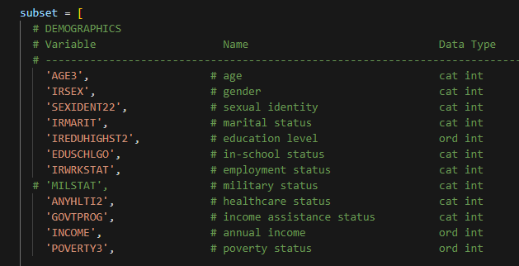
EDA Findings
Several utilized fields are logistic recodes from survey administrators, creating consistent representative survey population; the majority of recodes occur in the demographic fields.

Slide 6
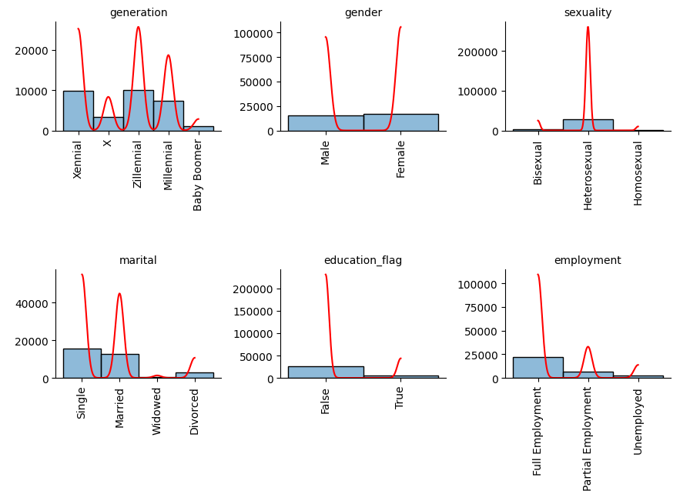
EDA Findings
Data fields consist of numerical, categorical, and ordinal values; all fields have numeric encodings inherent in survey sourcing and are translated to cat-strings for model representations
Categorical classes are reasonably balanced

Slide 7
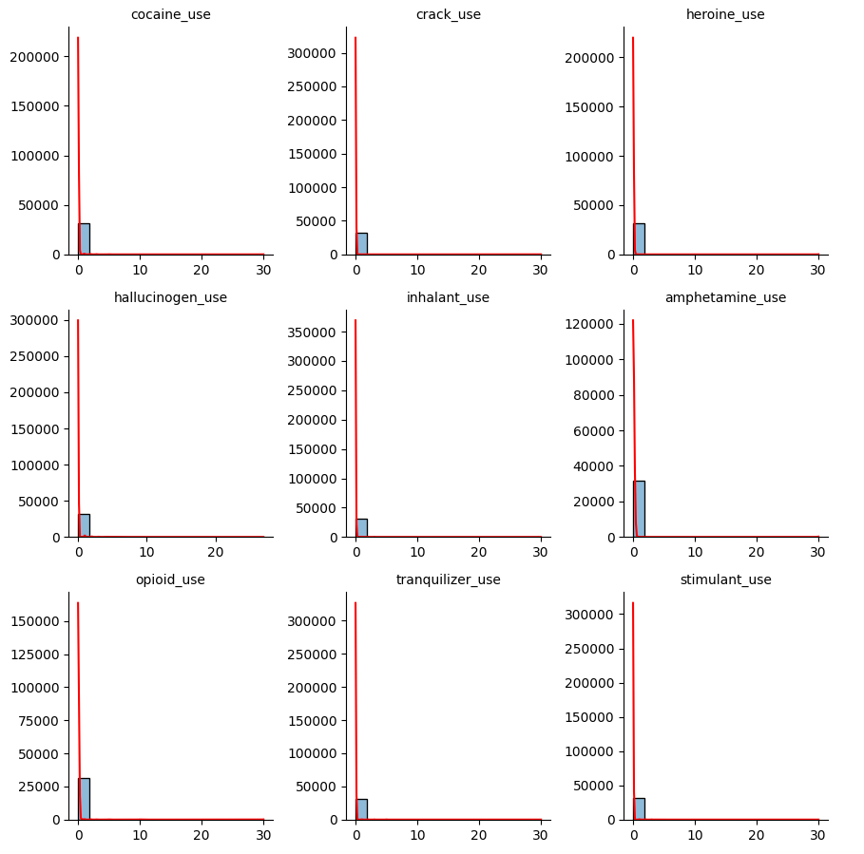
EDA Findings
Drug use fields are heavily right-skewed, requiring transformations to prevent distortion

Slide 8
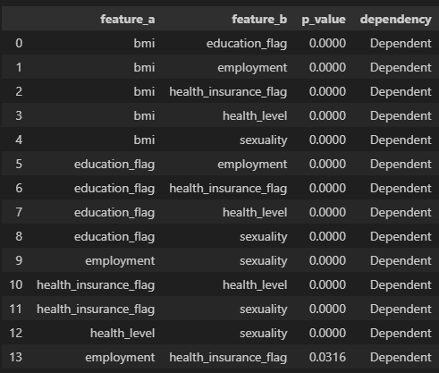
EDA Findings
Missing Dependency analysis showed 9 fields with intra-combination dependency
Results determined adolescents were the primary cause of major nullsets and were excluded from report analysis
Remaining fields were dropped for high null counts
Final dataset yielded 31,683 observations

Slide 9
Unlabeled Classification

Slide 10
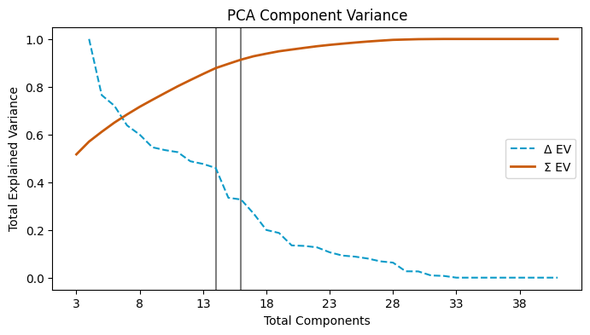

PCA Dimensioning
Results
Original 27 dimensions (47 transformed)
Final optimization of 16 dimensions
Explains over 90% variance

Slide 11
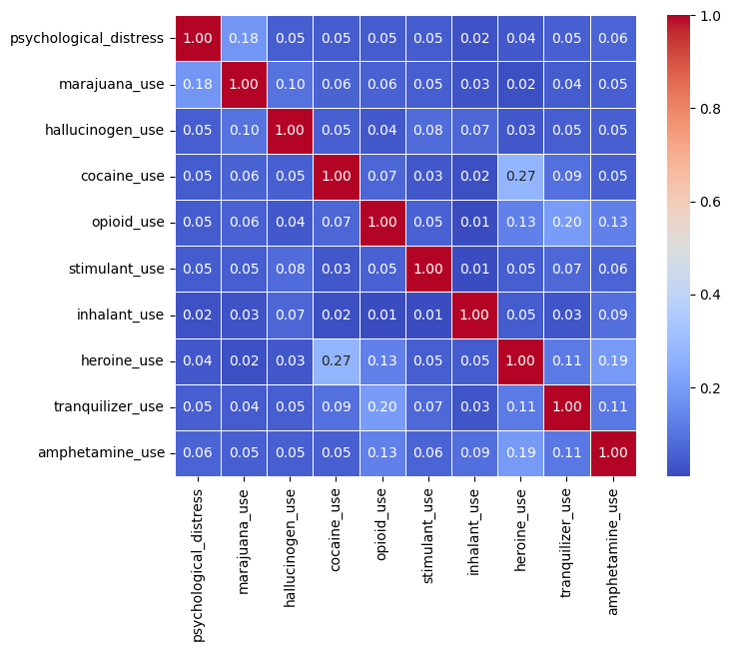
PCA Dimensioning
Influence Vectors
All drug use features showed high influence on component vectors
Physical drug dependence was not an influential factor but psychological distress was
No multicollinearity found in the results matrix

Slide 12
Unsupervised Model metrics
MODEL TYPE | MEASUREMENT | TARGET | ACHIEVED
Principle Component Analysis | % Explained Variance | 90 | 91.3
 | Total Components | -- | 16

Slide 13
Predictive Modeling

Slide 14
Model Selection
MODEL | REASONING / DETERMINATE
Logistic | Is overall health a linear composition of specific drugs or addictions?
Random Forest | Is overall health a compounded effect of the drugs or addictions?
Gradient Booster | Does the Random Forest model build with a systematic and cumulative error bound?
Support Vector Machines | Does classification perform better in n-dimensional (hyperplane) analysis?
The analysis fundamentally attempted to model predictive powers of health conditions and risks from drug use and addiction statuses.

Slide 15
supervised Model metrics
Health Level (Full set)
MODEL TYPE | % ACCURACY train | % ACCURACY test | # MEAN ABS ERROR
Linear Logistic | 45.75 | 44.64 | 0.64
w/ Forward Selection | 45.94 | 44.65 | 0.64
Random Forest | 86.99 | 12.01 | 0.74
Gradient Booster | 86.99 | 18.90 | 0.69

Slide 16
supervised Model metrics
Generation ID (drug use subset)
MODEL TYPE | % ACCURACY train | % ACCURACY test | # MEAN ABS ERROR
Linear Logistic | 42.16 | 40.86 | 0.68
Random Forest | 37.43 | 36.18 | 1.06
Support Vector Machine | 36.49 | 36.17 | 1.07

Slide 17
Results
Dimensioning techniques showed the majority of population demographics do not explain the classifications of drug use history or addiction statuses.
Top-Level prediction models are not substantive to determine drug uses; population refinement will likely yield better analysis

Slide 18
Sources
Primary Data
Research Citations
National Survey on Drug Use and Health (2023)
National Estimates of Marijuana Use and Related Indicators. Azofeifa A, Mattson ME, et. al. (2016)
Gender and prescription opioids: Findings from the National Survey on Drug Use and Health. Back, Sudie E., Payne, Rebecca L., et. al. (2010)
A clinical validation of the National Survey on Drug Use and Health Assessment of Substance Use Disorders. Jordan, B. Kathleen, Karg, Rhonda S., et. al. (2007)
Secondary Data
Center for Disease Control National Center for Health Statistics

Slide 19
THANK YOU
AJ Marcus
https://github.com/Malekyte/national-drug-use.git

